Slide 1
Key Dependent Image Steganography Using Edge Detection Hussein Asshabi

Slide 2
Spatial Domain Techniques
Spatial domain techniques embed the secret message/payload in the intensity of the pixels directly; which means they update the pixel data by either inserting or substituting bits. Lossless images are best suited for these techniques as compression would not alter the embedded data. These techniques have to be aware of the image format to make concealing information fool-proof.

Slide 3
LSB Substitution
This technique converts the secret message/payload into a bitstream and substitutes them into a least significant bit (the 8th bit) of some or all bytes inside an image. The alterations happen on the least significant bit which changes the intensity by +-1 which is extremely difficult for the human eye to detect.

Slide 4
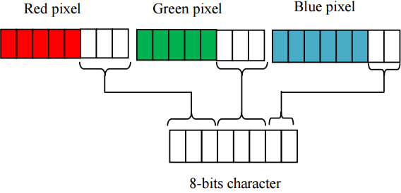
LSB Substitution for RGB Colors

Slide 5

Right Image has about 1KB long text message

Slide 6
Randomized LSB
A regular LSB substitution technique starts substituting from pixel 0 and goes till n making this method highly predictable. To make things slightly challenging sender and receiver could share a secret key through which they agree on the certain pixels that will be altered making the technique more robust.

Slide 7
PRELIMINARIES
To develop a new key dependent LSB steganography scheme using edge detection technique that can resist steganalysis, we modify the Chen et al. scheme.
The modified mechanism allows selecting random number of LSBs based on secret key which are used to replace secret message.
The chaotic logistic map employed for random sequence generation and canny edge detector to extract the edges of cover image are described as follows.

Slide 8

Chaotic 1D Logistic Map
$$w(n+1)=λw(n)(1– w(n))$$
Where w(0) is initial condition, is the system parameter and n is the number of iterations. The research shows that the map is chaotic for 3.57 < < 4 and w(n+1) ∈(0, 1) for all n.

Slide 9
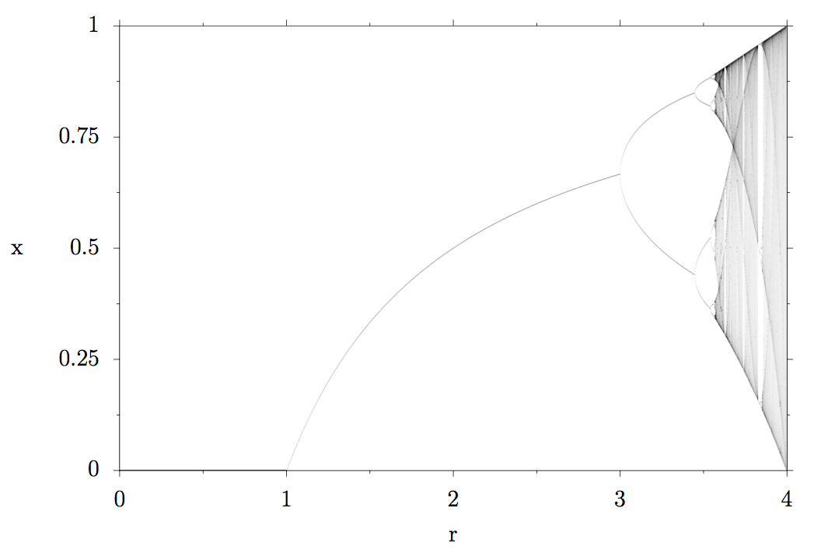
Chaotic 1D Logistic Map

Slide 10
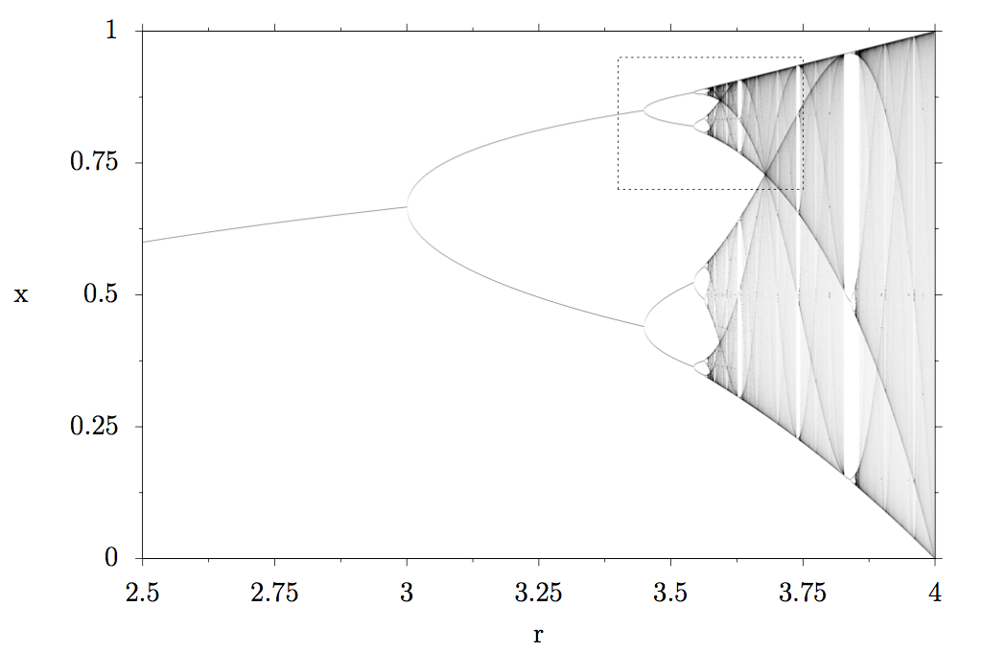
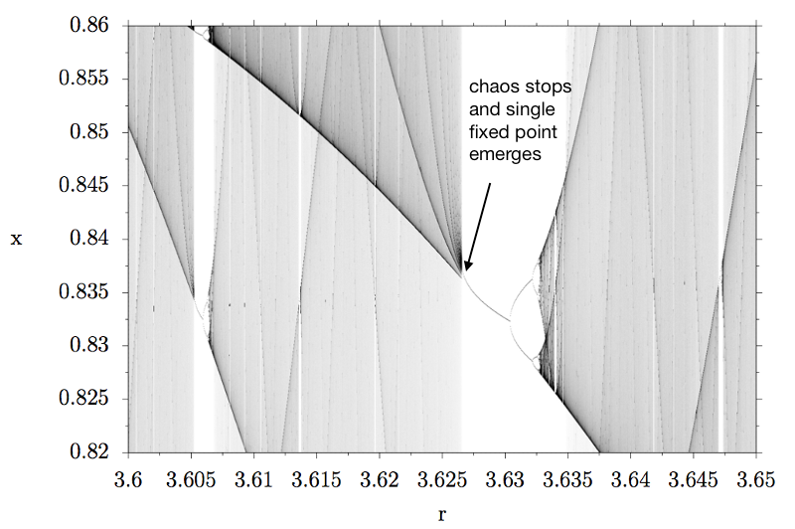
Chaotic 1D Logistic Map

Slide 11
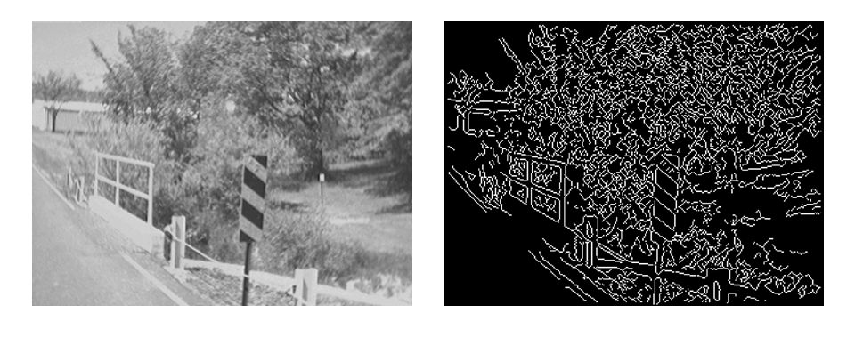
Canny Edge Detection
An edge is characterized by significant dissimilarity in gray levels being used to indicate boundary between two regions in an image.

Slide 12
Embedding METHOD
Step 1: Apply canny edge detection to obtain edge image B from gray scale image G.
Step 2: Divide the gray scale image into set of blocks, each block containing n-pixels. Here we use P1 pixel to store status of other pixel. The status of each pixel Pi, is defined as ‘1’ if it is a edge pixel. Otherwise is ‘0’ if non-edge pixel. The status of pixels from P2 to Pn is stored inside P1 by LSBs substitution operation. To preserve the quality of pixel P1 as well as to increase the embedding payload, based on the experimental results, we suggest assigning the values of n as 3, 4.

Slide 13
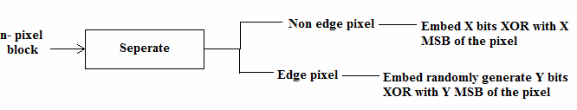
Classification and embedding of pixels
Step 3: For a non edge pixel in a block we embed ‘x’ bits of message XOR with ‘x’ MSBs of the pixel by LSB substitution. To maintain the quality of the stego image, the value of x here is 1 or 2.

Slide 14
Classification and embedding of pixels
Step 4: For an edge pixel in a block, we embed ‘y’ bits of message XOR with ‘y’ MSBs of the pixel by LSB substitution. The value of ‘y’ is generated randomly for each pixel using chaotic map. To maintain the quality of stego image, the value of y is generated between 1 and 4.

Slide 15
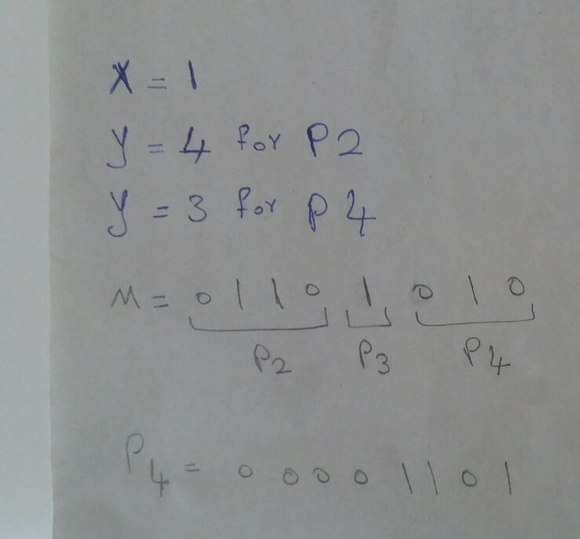
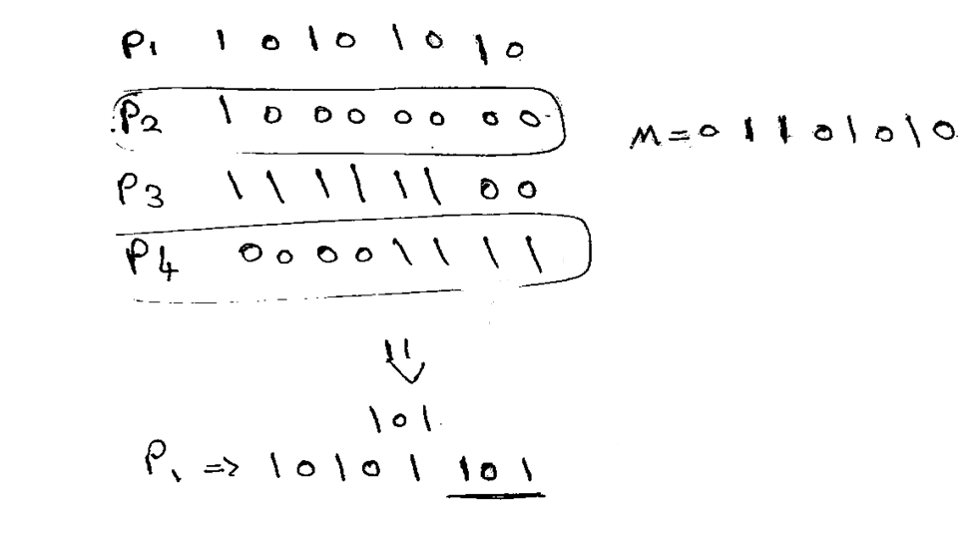
Example

Slide 16
Extraction process
Step 1: Similar to the dividing operation presented in the previous procedure. Divide the stego image into npixels block.
Step 2: Based on the (n - 1) LSBs in pixel P1’, we obtain the status of the remaining pixels from P2’ to Pn’. From this status value, we can identify two categories corresponding to the non-edge pixel category and the edge pixels category.
Step 3: From non-edge pixel, based on the value of ‘x’ used in embedding process, extract the ‘x’ LSBs of the pixel and XOR it with the ‘x’ MSBs of the pixel to obtain the bits of original message.
Step 4: From edge pixel, based on the value of ‘y’ generated randomly, extract ‘y’ LSBs of the pixel and XOR it with the ‘y’ MSBs of the pixel to achieve part of message. The value of ‘y’ generated will be same for a pixel in embedding & extraction if the secret key i.e. initial value w(0) of chaotic map is same on sender & receiver side.

Slide 17
Thank You

